Slide 1

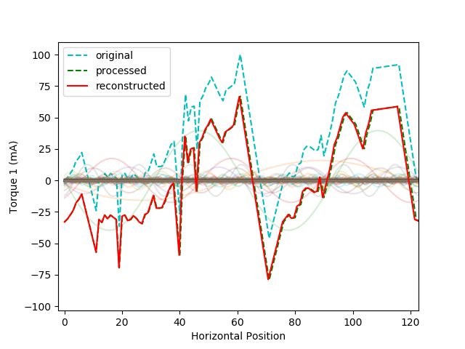
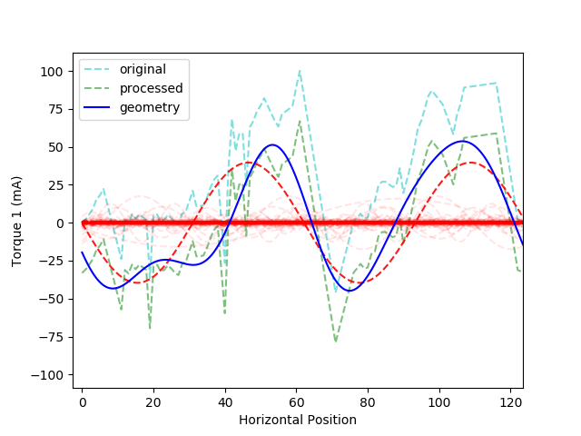
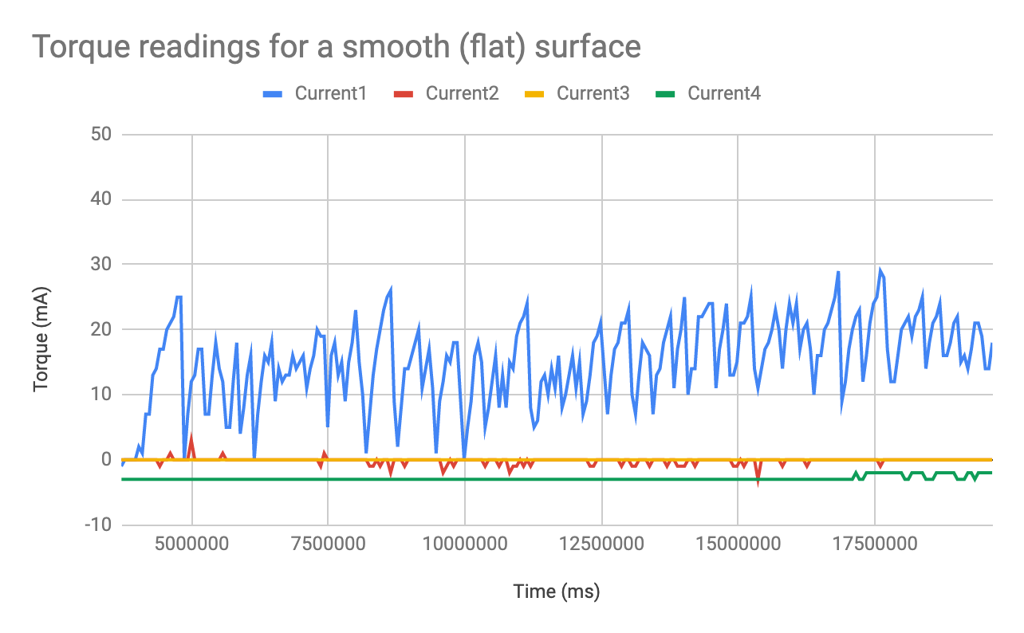
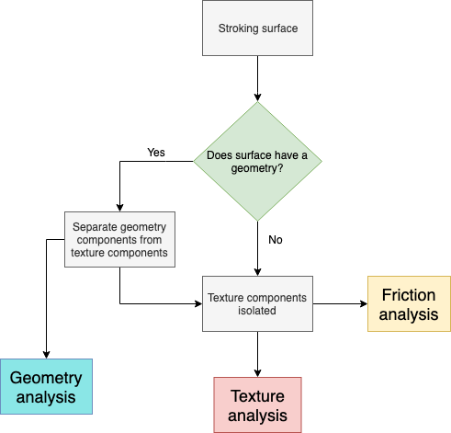
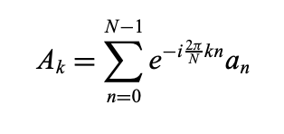
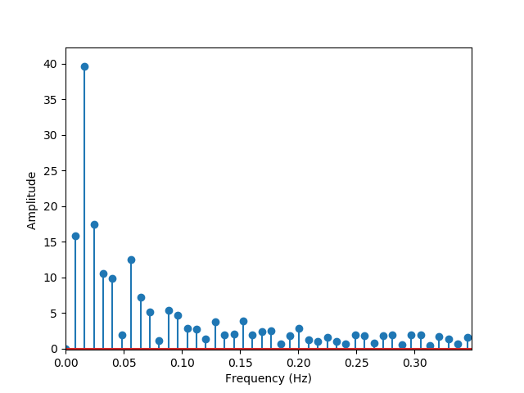
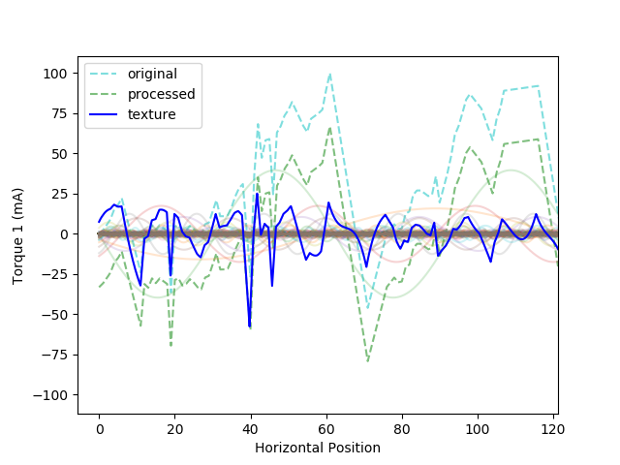
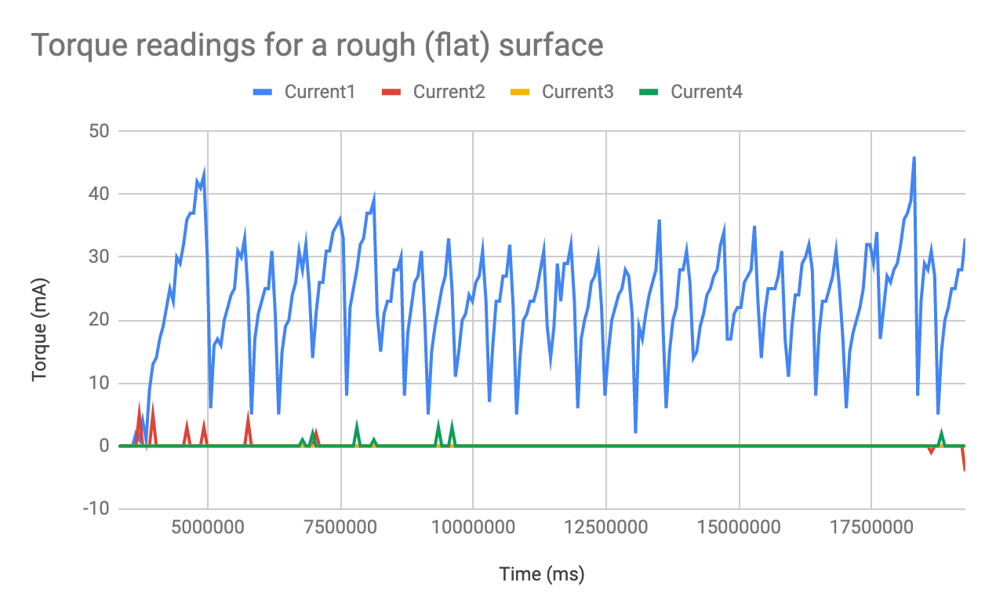
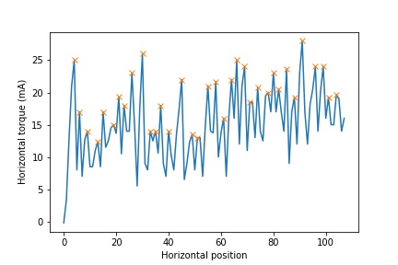
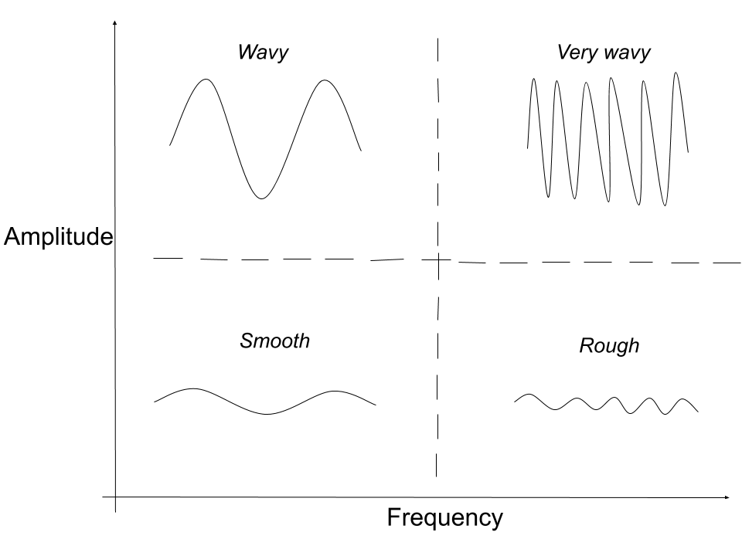
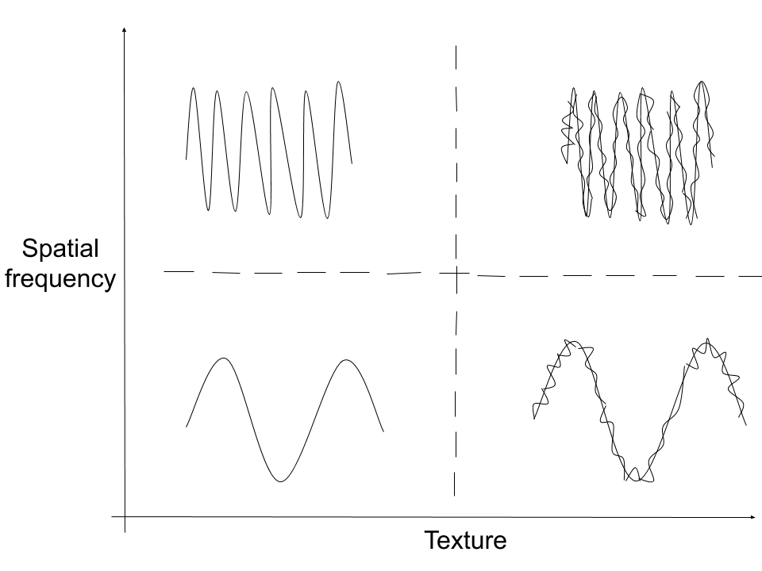
Haptic Perception for Surface Geometry, Texture and Friction
Jason Ryan Ah Chuen, Akram Sbaith, Charles Pan, Kenneth Salisbury
Salisbury Robotics Lab, Stanford Artificial Intelligence Laboratory, Stanford University
Introduction
Geometry Analysis
Texture Analysis
One of the primary ways of identifying a surface is by stroking it to see how rough or smooth or coarse it is (texture), whether it is flat or wavy or has another pattern (geometry), and how slippery it is (friction). We made a model that can, within one stroke, discriminate between each of those 3 overlapping features, and then identify them separately.
Separating geometry from texture to analyze them separately
Comparing standard deviations of torque readings obtained during stroking
Fast Fourier Transform
Inverse Fourier Transform
Fig 1A (s.d1 = 6.79, s.d2 = 0.89, s.d3 = 0)
Fig 1B (s.d1 = 8.81, s.d2 = 0.64, s.d3 = 0)
Friction analysis
Discussion
Conclusion
Calculating friction coefficient
Machine learning models (KNN and multinomial logistic regression) can accurately classify surfaces using amplitude and frequency of their characteristic waves, and standard deviations of the torque readings as predictors.
Future models could be made to predict the exact geometry using the position scan obtained already from stroking.
It is also worth investigating how friction affects texture, or vice versa.
F_{H} = Horizontal force
= Average of the llllllllpeak heights
F_{V} = Normal contact ;;;;;;;force
μ = Friction coefficient
= F_{H} / F_{V}
Geometry can be considered high amplitude texture
Range of all possible combinations of texture and geometry in a surface
Acknowledgements
We thank Professor Kenneth Salisbury for his valuable advice and contributions to this project. We also thank Ante Qu for building the robotic arm which we used in our experimentations, and Charles Pan for working on the utility features of the arm together.
Decision Tree

